Slide 1
Designing for Coastal Resiliency Through a Transdisciplinary Lens

Slide 2
What We’ll Talk About Today
Description of the NASEM Gulf Scholars Program
Mission and principles.
Key learning objectives.
Overview of the GSP at MSU
Motivation and structure.
Student/faculty opportunities.
Topics for discussion (towards research and development)
Defining interdisciplinary.
The Path is the Discovery.
Collaborative Strategies.

Slide 3
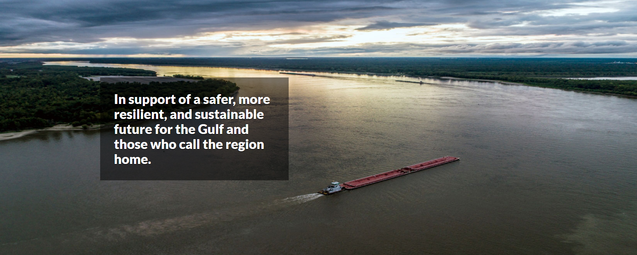
Gulf Research Program
“…the GRP will use science, engineering, and medical knowledge to empower citizens and to enhance knowledge and decision-making.”

Slide 4
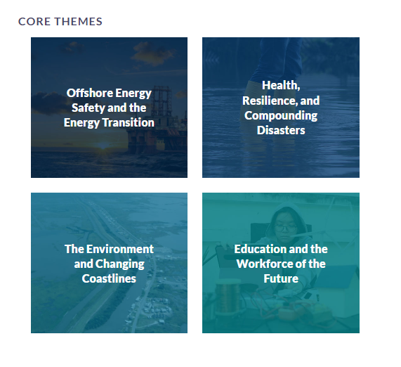
Gulf Research Program
“...to enhance knowledge and decision-making.”
ENERGY
HEALTH
ENVIRONMENT
EDUCATION

Slide 5
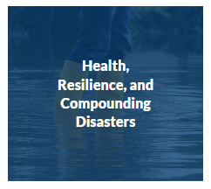
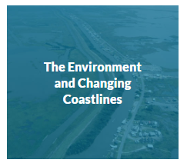
Gulf Scholars Program
The Gulf Scholars Program (GSP) is a five-year pilot project of the Board on Gulf Education and Engagement (BGEE), within the Gulf Research Program Division.
Supports colleges and universities in the Gulf of Mexico region in preparing undergraduate students to address critical challenges related to the focus areas of the GRP.

Slide 6
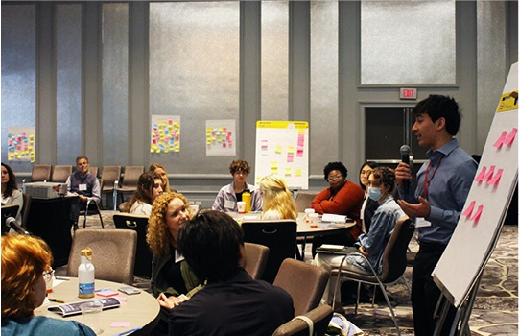
Gulf Scholars Program - Mission
Participating schools engage students from across the sciences, engineering, medicine, humanities, arts, and beyond to develop key competencies and mindsets necessary to address critical Gulf challenges.
Each participating institution will establish its own organizational structure and pathways of curricular, co- and extra-curricular activities for student engagement and learning.

Slide 7
Gulf Scholars Program - Principles
The Gulf Scholars Program…
specifies key learning outcomes necessary for students to address these challenges.
Six outcomes to address program requirements and goals.
provides funding for participating schools.
Up to $500k over five years, with incentives for partnering with community colleges.
supports the development of a region-wide network of GSP schools and students.
By the end of the pilot phase (2025), the GRP will involve more than 25 public and private universities across the Gulf.

Slide 8
1 - Regional Knowledge
The GSP specifies six key learning outcomes:
Knowledge of the Gulf Region
Knowledge of the region's human cultures and physical and natural worlds.

Slide 9
2 - Integrative Learning
The GSP specifies six key learning outcomes:
Knowledge of the Gulf Region
Multidisciplinary and integrative learning
Ability to connect knowledge from multiple disciplines, over time, built across college, community and life experiences.

Slide 10
3 - Intercultural Competency
The GSP specifies six key learning outcomes:
Knowledge of the Gulf Region
Multidisciplinary and integrative learning
Intercultural knowledge and competencies
Skills and characteristics that support effective and appropriate interaction in a variety of cultural contexts.

Slide 11
4 - Social Responsibility
The GSP specifies six key learning outcomes:
Knowledge of the Gulf Region
Multidisciplinary and integrative learning
Intercultural knowledge and competencies
Social responsibility and ethical reasoning
In promoting the quality of civic life, equity, and sustainability of Gulf communities.

Slide 12
5 - Innovation
The GSP specifies six key learning outcomes:
Knowledge of the Gulf Region
Multidisciplinary and integrative learning
Intercultural knowledge and competencies
Social responsibility and ethical reasoning
Innovation and entrepreneurialism
Ability to develop and implement innovative solutions and responses to major Gulf challenges.

Slide 13
6 - Community Engagement
The GSP specifies six key learning outcomes:
Knowledge of the Gulf Region
Multidisciplinary and integrative learning
Intercultural knowledge and competencies
Social responsibility and ethical reasoning
Innovation and entrepreneurialism
Gulf Impact Project
A mentored research/creative project, focused on one or more of the core areas of the GRP.

Slide 14
What We’ll Talk About Today
Description of the NASEM Gulf Scholars Program
Mission and principles.
Key learning objectives.
Overview of the GSP at MSU
Motivation and structure.
Student/faculty opportunities.
Topics for discussion (towards research and development)
Defining interdisciplinary.
The Path is the Discovery.
Collaborative Strategies.

Slide 15
The GSP at MSU
https://www.nationalacademies.org/news/2023/10/third-cohort-of-universities-joins-gulf-scholars-program

Slide 16
Program Overview
GSP
Environmental Science
Economics
Communication
Social Science
History
Geography
Art and Design
The overarching theme of the GSP at MSU is “designing for resiliency”, whereby students will define and assess resiliency through a transdisciplinary lens.
The focus is on the path to discovery more than realizing a solution.
Combines expertise and experience from across campus within a single educational framework.

Slide 17
GSP Learning Objectives
It is a combination of skills, knowledge, and perspectives that are necessary for the generation of true change agents.
Positive change requires both an understanding of the issues as well as the skills necessary to strategize and implement viable solutions.
Scientific understanding
Effective communication
Interdisciplinary training
Social perspectives
Adaptability
Collaborative mindset
Critical thinking
Regional knowledge

Slide 18
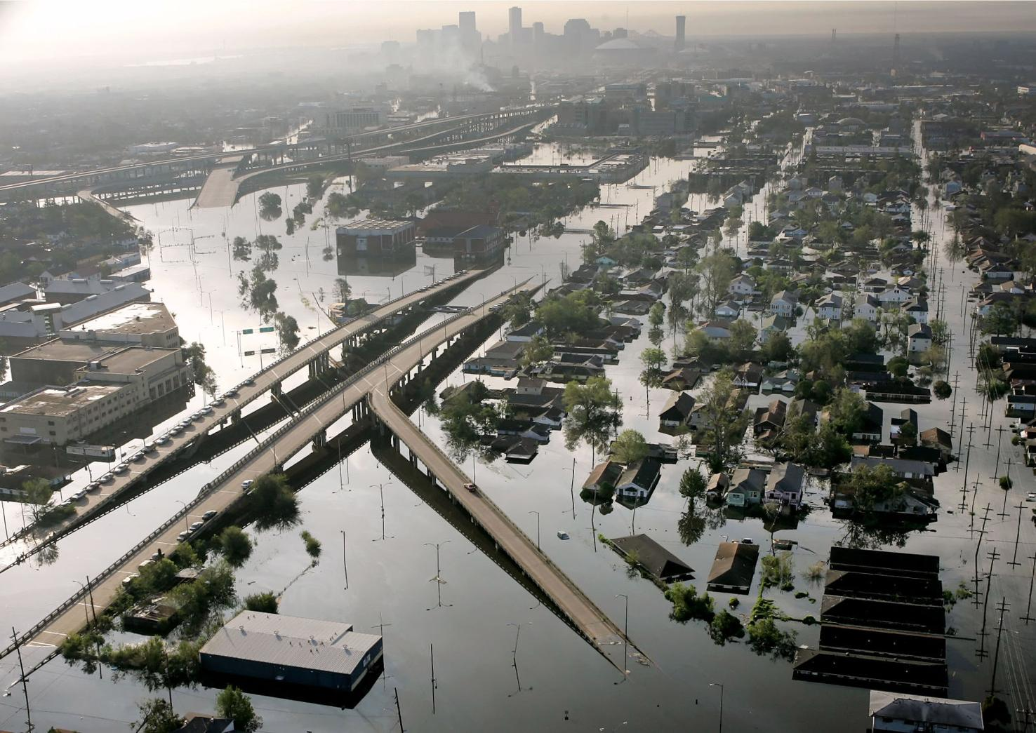
Understand the Issues
In better understanding the issues within and connections between various disciplines in the sciences and humanities, students will learn to assess the ability (or inability) of a community to respond to the threat and impact of natural and human disasters.

Slide 19
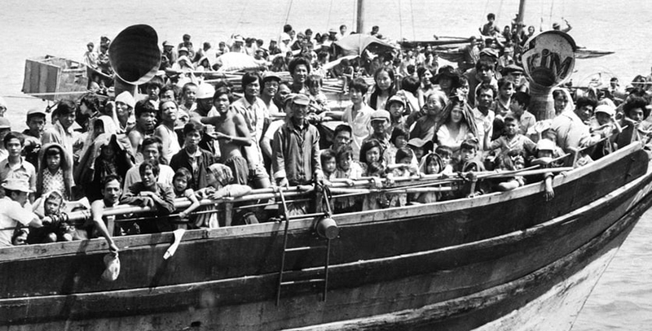
Recognize the Challenges
The Gulf Coast is a region indelibly marked by industrialization, immigration, and globalization, resulting in a place where local human and environmental history have taken on a distinctly coastal character.
The Gulf Coast’s challenges are going to need solutions that are rooted in the experiences and concerns of the local communities.

Slide 20
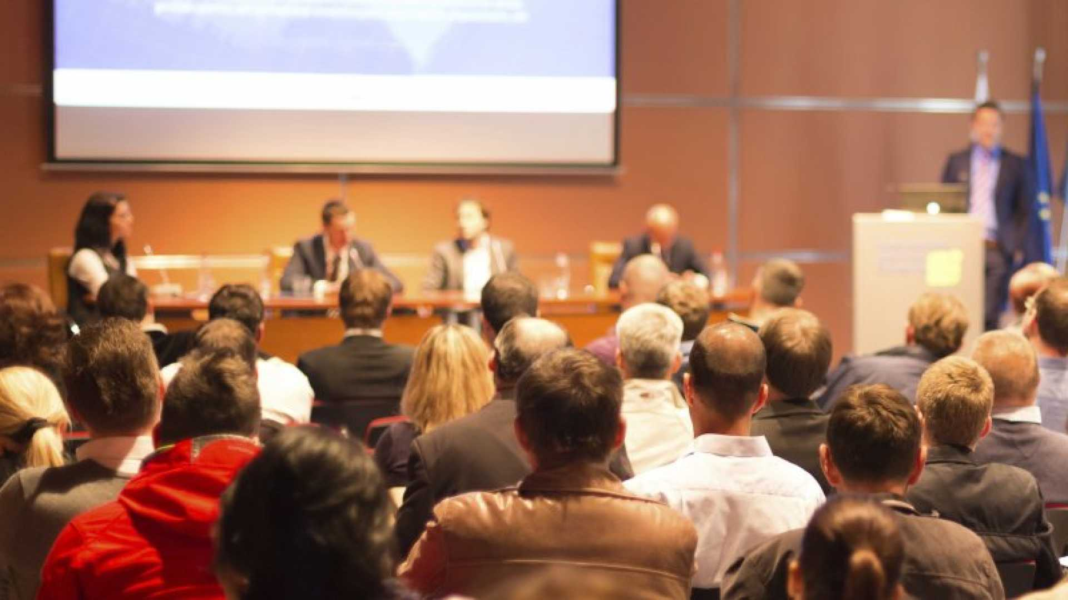
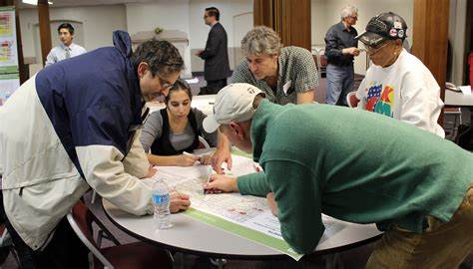
Communicate and Collaborate
The GSP will train students to communicate and work collaboratively in a constantly changing atmosphere of diverse thoughts, ideas, personalities, and ambitions.

Slide 21
Work Towards Solutions
The goal is to develop Gulf Scholars who bring two complementary qualities towards solving complex, ill-structured problems impacting the Gulf Coast region.
Knowledge across disciplines: Gain deep understanding of the Gulf Coast region's issues through an interdisciplinary curriculum
Innovation with empathy: Develop solutions using innovative techniques based on empathy, problem-solving, iteration, and collaboration.
GSP students will work to educate and engage Gulf Coast residents in their designs to realize their role as future change-agents in local communities.

Slide 22
Faculty Opportunities
The GSP program and associated Minor in Gulf Coast Studies will utilize existing and proposed MSU courses with a focus on one or more Gulf Coast topics.
Ideally the courses can be taken by any MSU student, whether they are working towards the Minor or not (e.g., General Education and/or foundational courses).
Faculty are encouraged (and incentivized) to develop or modify courses to fit within the goals of the GSP.
Students in the GSP program will be involved in experiential learning and development activities:
Trip to the Gulf Coast for learning and discovery at the beginning of the program.
Faculty-led research/outreach project at the culmination of the program in partnership with MSU and/or community programs.

Slide 23
Building Research Through Academics
Build an academic program combining interdisciplinary teaching of fundamental aspects of Gulf Coast issues with training in collaborative strategy design and implementation.
Students better able to handle ill-structured (a.k.a., “wicked”) problems.
Students more equipped to work in dynamic and fluid scenarios.
Students more likely to recognize career interests and match quality.
Capstone projects will emphasize community engagement to connect students’ knowledge through meaningful strategies.
Students more connected to critical and “real world” challenges.
Students able to recognize the path to discovery as part of the research process.
Students able to define and recognize feedbacks among systems.

Slide 24
Building Research Through Academics
Build an academic program combining interdisciplinary teaching of fundamental aspects of Gulf Coast issues with training in collaborative strategy design and implementation.
Faculty better able to handle ill-structured (a.k.a., “wicked”) problems.
Faculty more equipped to work in dynamic and fluid scenarios.
Faculty more likely to recognize career interests and match quality.
Capstone projects will emphasize community engagement to connect students’ knowledge through meaningful strategies.
Faculty more connected to critical and “real world” challenges.
Faculty able to recognize the path to discovery as part of the research process.
Faculty able to define and recognize feedbacks among systems.

Slide 25
What We’ll Talk About Today
Description of the NASEM Gulf Scholars Program
Mission and principles.
Key learning objectives.
Overview of the GSP at MSU
Motivation and structure.
Student/faculty opportunities.
Topics for discussion (towards research and development)
Defining interdisciplinary.
The Path is the Discovery.
Collaborative Strategies.

Slide 26
Defining Interdisciplinary
There are levels of integration among disciplines, leading to different design approaches and strategies.
Multi = Additive Inter = Integrative Trans = Holistic

Slide 27
The Path is the Discovery
We often focus on the solution as the end goal.
What is the deliverable? What product can we produce/provide?
We should also be mindful of the connections and directions we take towards discovery.

Slide 28
Collaborative Strategies
Group work, team building, collaboration, strategies… We’re told to do this (and we ask our students to do it), but do we even know how to do it?
Collaboration is a skill that should be taught and practiced.

Slide 29
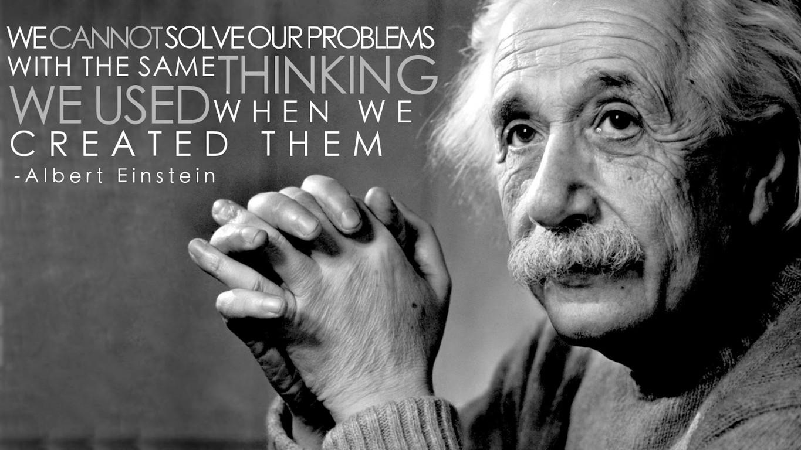
Collaborative Strategies

Slide 30
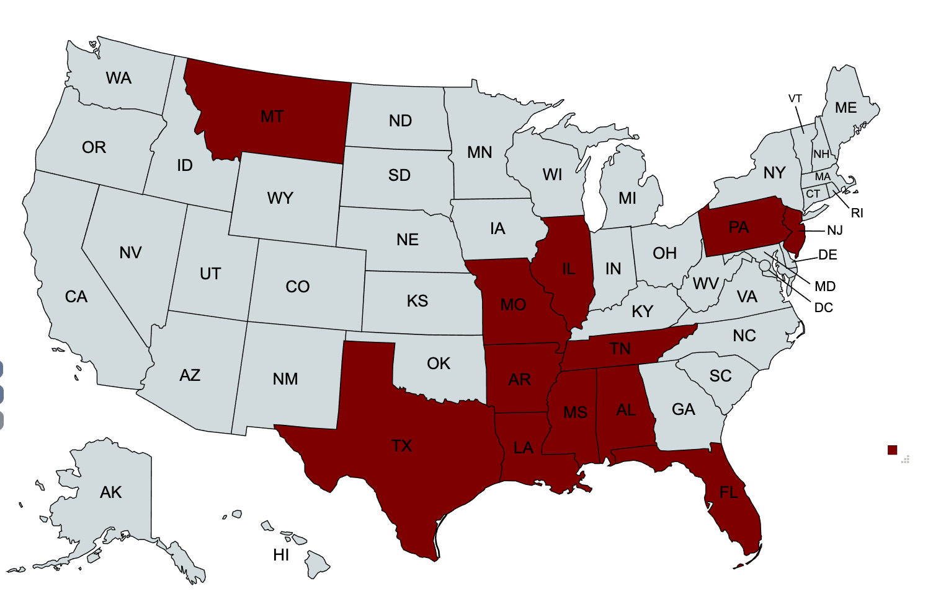
Collaborative Strategies
How might we help people work together effectively
in a rapidly-changing world?

Slide 31
Collaborative Strategies
We live in an age of transformation

Slide 32
Collaborative Strategies
Facing complex, tangled, wicked challenges

Slide 33
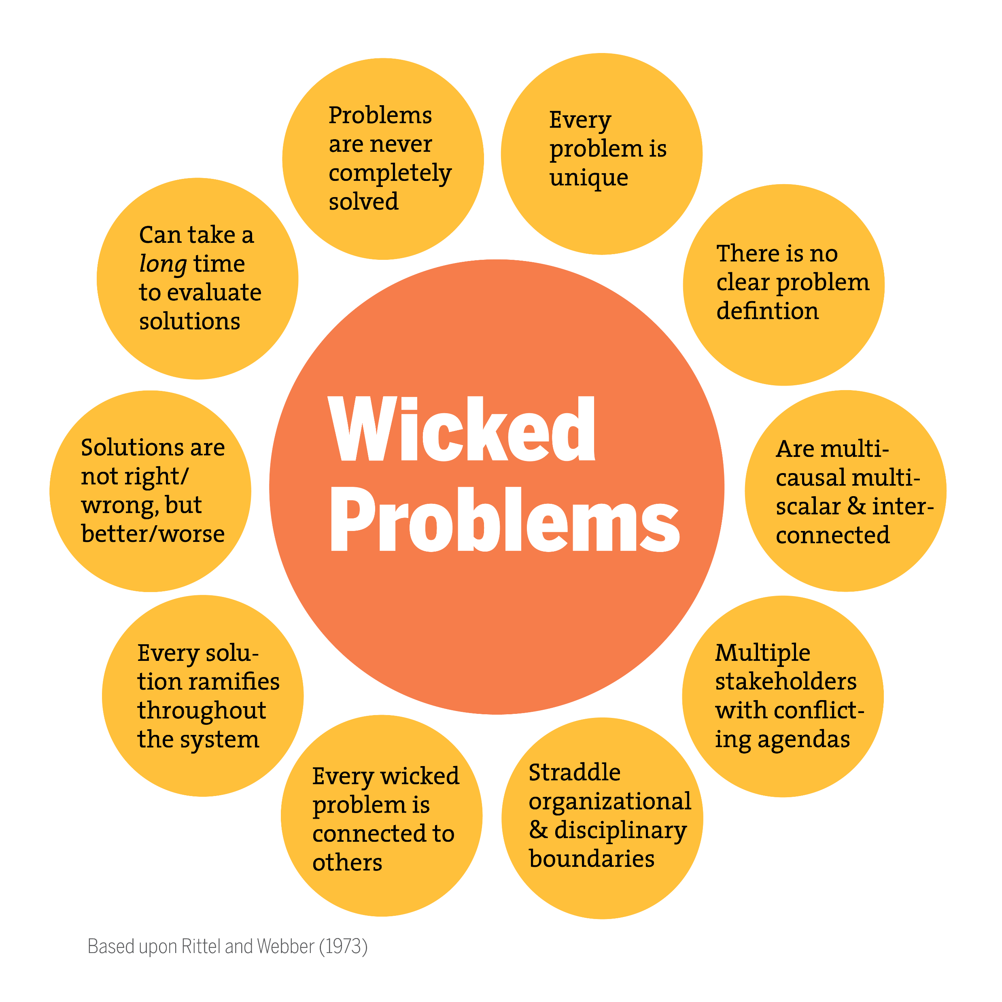
Collaborative Strategies
Poverty
Healthcare
Education
Economic development
Postsecondary access
Student belonging
Diverse learning pathways
What wicked challenges do you see?

Slide 34
Collaborative Strategies

Slide 35
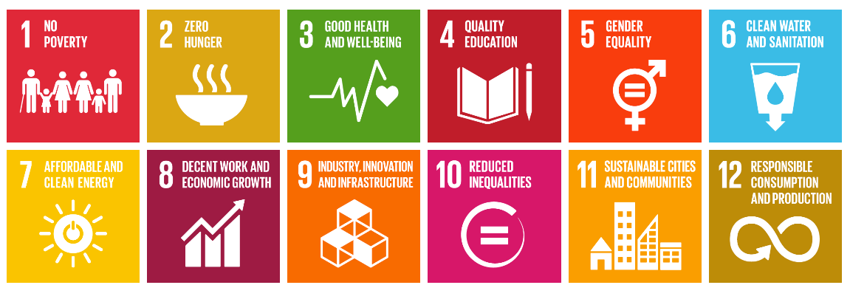
Collaborative Strategies
No single entity or organization is in charge

Slide 36
Collaborative Strategies

Slide 37
Collaborative Strategies
Using the wrong tools

Slide 38
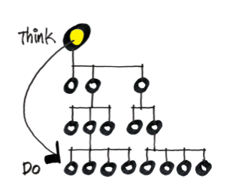
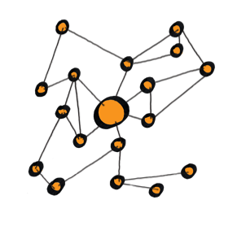
Collaborative Strategies
We need an approach to strategy and problem-solving that works for different environments

Slide 39
Collaborative Strategies & the GSP
Develop key collaboration competencies and mindsets necessary to address critical gulf challenges.
Prepare undergraduate students to address critical challenges

Slide 40
Collaborative Strategies & the GSP

Slide 41
Energy & Commitment
Intellect & Innovation
Emotional Intelligence & Well-Being
Transdisciplinary Collaboration & Community
KEY
CAPACITIES OF
CHANGE
AGENTS
Reflexivity, Reflection, & Action

Slide 42
Collaborative Strategies – T-shaped skills
Cross-discipline competencies and the ability to collaborate
Discipline / knowledge of a field

Slide 43
Collaborative Strategies – T-shaped skills
Cross-discipline competencies and the ability to collaborate
Discipline / knowledge of a field

Slide 44
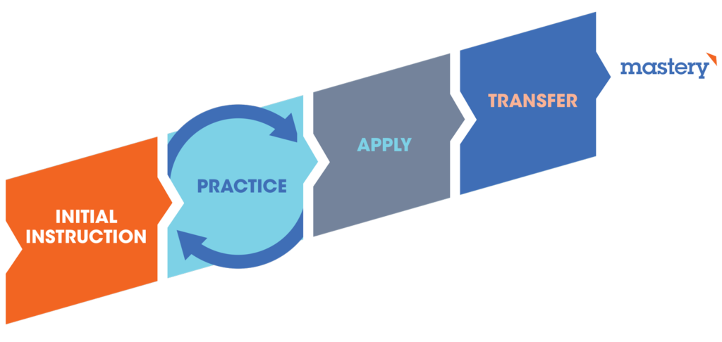
Collaborative Strategies
Collaboration is a skills that can be practiced, and over time, mastered

Slide 45
Collaborative Strategies
Trust
Co-Creation
Co-Execution
Turf
Sharing
Resources
Sharing
Information
Mutual
Awareness
Acknowledgment
Exploration
Cooperation
Teamwork
Collaboration

Slide 46
Collaborative Strategies
Drawn from various disciplines and approaches:
Design thinking
Agile,
Innovation science,
Lean
Asset-based development,
Appreciative inquiry, and
Collective impact
Development of courses that introduce various skills to help foster and guide collaborative action.

Slide 47
Collaborative Strategies – Sample
Collaborative
prioritization
Ideation/
Brainstorming
Experimentation/
Prototyping
Reframing problems
Continuous Learning
& Improvement

Slide 48
Collaborative Strategies

